Slide 1
Chapter 2
Data Science Process

Slide 2
Data: The Raw Facts
a "given" or a fact that represents something in real world
raw materials, can be processed, structured or unstructured
Data are elements of analysis
Information: Data in Context
Data that have meaning in context
Data related
Data after manipulation
Knowledge: Understanding and Application
familiarity, awareness and understanding of someone or something
acquired through experience or learning
it is a concept mainly for humans unlike data and information.
Knowledge is not information and information is not data.
Knowledge is derived from information in the same way information is derived from data.

Slide 3
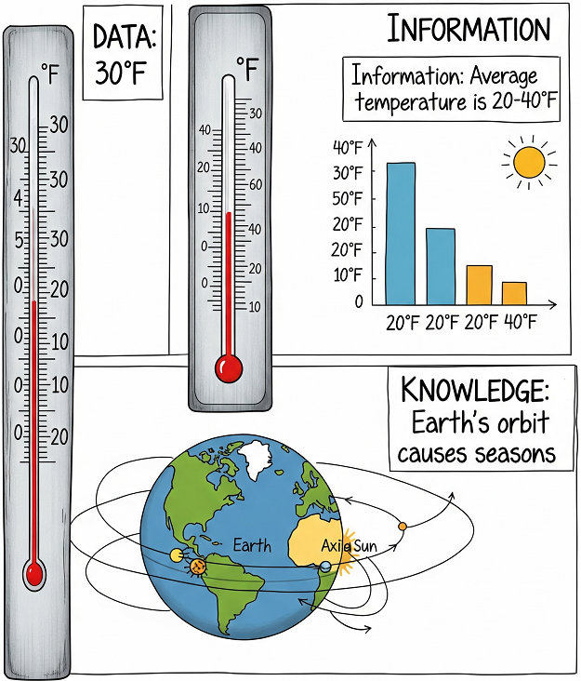
Example
Data: It is 30 degrees Fahrenheit outside at the moment. (It is a single fact.)
Information: The average temperature for this time of the year ranges from a high of 40 degree to a low of 20 degrees. (This “informs” your internal conceptual model of reality so you can act accordingly.)
Knowledge: It is warmer in the summer and colder in the winter due to the orbit cycle of the earth. (Adds some causal explanation and predictability.)
Notes:
https://www.quora.com/Can-someone-give-a-simple-example-for-data-information-knowledge-and-wisdom

Slide 4
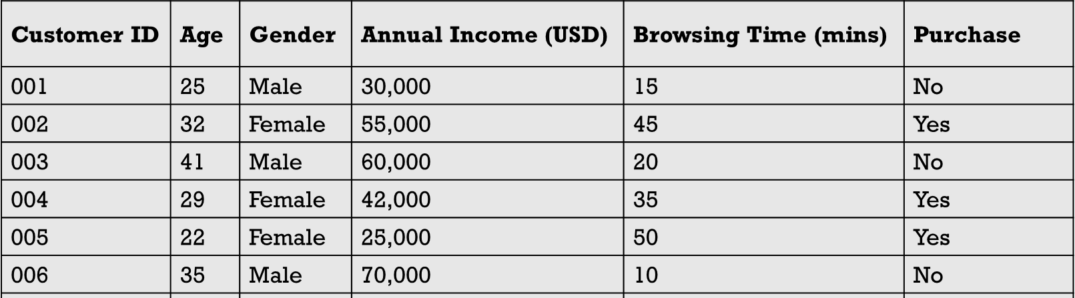
Data Types
Two types of data: Labelled Data & Unlabelled Data
Labelled data
Specially designated attribute and the aim is to use the data given to predict the value of that attribute for instances that have not yet been seen.
Age=30, Gender=Male, Income=50k, Browsing Time=10, THEN Purchase = ?

Slide 5
Data Types
Customer ID | Age | Annual Income (USD) | Spending Score (1–100)
C001 | 25 | 45,000 | 77
C002 | 34 | 60,000 | 43
C003 | 22 | 25,000 | 88
C004 | 31 | 52,000 | 52
C005 | 45 | 85,000 | 26
C006 | 38 | 75,000 | 29
C007 | 27 | 33,000 | 81
C008 | 40 | 90,000 | 35
C009 | 30 | 48,000 | 66
C010 | 23 | 20,000 | 91
Unlabelled data
Data that does not have any specially designated attribute is called unlabelled.
Here the aim is simply to extract the most information we can from the data available.

Slide 6
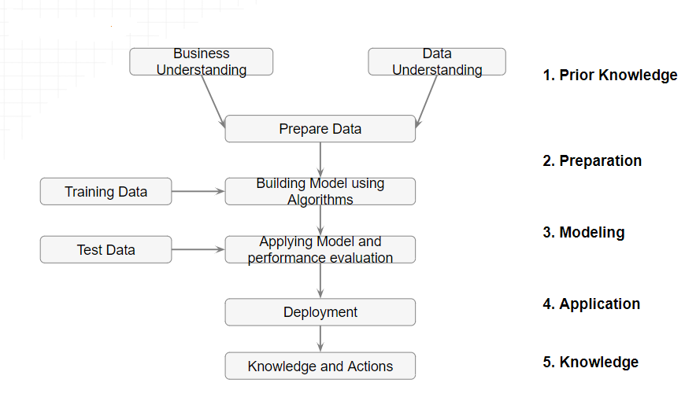
Data Science Process

Slide 7
Prior Knowledge
Gaining information on:
Objective of the problem
Subject area of the problem
Data

Slide 8
Prior Knowledge: Objective of the problem
The data science process starts with a need for analysis, a question, or a business objective. This is possibly the most important step in the data science Process.
Without a well-defined statement of the problem, it is impossible to come up with the right dataset and pick the right data science algorithm.

Slide 9
Prior Knowledge: Subject area of the problem
The process of data science uncovers hidden patterns in the dataset by exposing relationships between attributes. But the problem is that it uncovers a lot of patterns.
The false or spurious signals are a major problem in the data science process.
It is up to the practitioner to sift through the exposed patterns and accept the ones that are valid and relevant to the answer to the objective question.
Hence, it is essential to know the subject matter, the context, and the business process generating the data.

Slide 10
Prior Knowledge: Data
Understanding how the data is collected, stored, transformed, reported, and used is essential to the data science process.
There are quite a range of factors to consider: quality of the data, quantity of data.
The objective of this step is to come up with a dataset to answer the business question through the data science process.
For the following example, a sample dataset of ten data points with three attributes has been put together: identifier, credit score, and interest rate. First, some of the terminology used in the data science process are discussed.

Slide 11
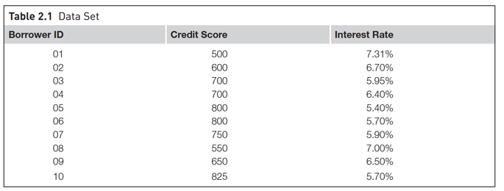
A dataset (example set) is a collection of data with a defined structure. Table 2.1 shows a dataset. It has a well-defined structure with 10 rows and 3 columns along with the column headers. This structure is also sometimes referred to as a “data frame”.
A data point (record, object or example) is a single instance in the dataset. Each row in Table 2.1 is a data point. Each instance contains the same structure as the dataset.
An attribute (feature, input, dimension, variable, or predictor) is a single property of the dataset. Each column in Table 2.1 is an attribute. Attributes can be numeric, categorical, date-time, text, or Boolean data types. In this example, both the credit score and the interest rate are numeric attributes.

Slide 12
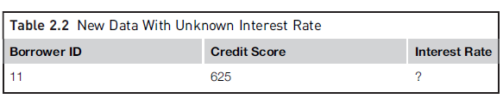
A label (class label, output, prediction, target, or response) is the special attribute to be predicted based on all the input attributes. In Table 2.1, the interest rate is the output variable.

Slide 13
Data Science Process

Slide 14
Data Preparation
Data Exploration
Data quality
Missing values
Data types and Conversion
Transformation
Outliers
Feature selection
Sampling

Slide 15
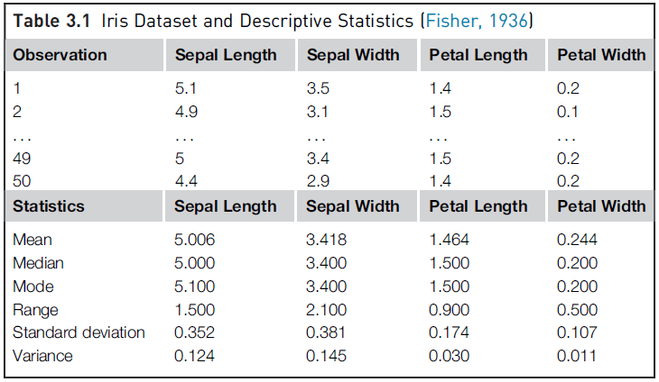
Data Preparation: Data Exploration
Data preparation starts with an in-depth exploration of the data and gaining a better understanding of the dataset. Data exploration, also known as exploratory data analysis, provides a set of simple tools to achieve basic understanding of the data. Data exploration approaches involve computing descriptive statistics and visualization of data.
Dataset
Descriptive Statistics

Slide 16
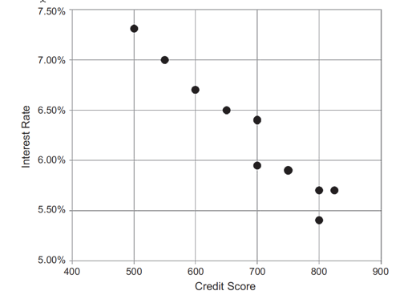
Data Preparation: Data Exploration
Dataset
Visualization

Slide 17
Data Preparation: Data Quality
Data quality is the measure of how well suited a data set is to serve its specific purpose. Measures of data quality are based Data Correctness, Data Freshness and Data Completeness.
Data Correctness: How accurately the data value describes real-world facts. For example, a B2B sales rep wishes to look at a prospect company’s number of employees. If they accidentally grab the wrong company from their database, because its name and location are similar to another organization, they will report a wrong number, be misinformed, and potentially lose an opportunity to sell to a qualified prospect. In this case, the rep used incorrect data. The data correctness metric is usually measured with classification metrics such as precision – a compound of correct data points compared to incorrect data points. There are many potential root causes of collection issues such as collection noise, faulty data transformations, outdated data, or incorrect schema description.

Slide 18
Data Preparation: Data Quality
Data Freshness : This refers to how relevant the data is to describe the current state of an entity, and takes into consideration the timeliness of the data and how frequently it is updated. This is a tricky measurement as “freshness” ranges from data that is updated in real-time to data that is updated annually. Each business use case will differ in its data freshness thresholds and requirements. For example, data that doesn’t change frequently, like a person or institution name, would not require the same freshness as stock market or Twitter trends. In any case, data must be up-to-date, if it is not it could mislead a decision. This metric is typically measured with time

Slide 19
Data Preparation: Data Quality
Data Completeness : A measure which describes how whole and complete a data asset is. Completeness is especially important when you want to attach new attributes to your existing data. In cases where you have low coverage, you would get limited support for the different attributes that you enrich, and the data becomes less useful. Coverage is also important if you want to extract insights from your dataset.

Slide 20
Data Preparation: Missing Values
Student ID | Name | Math Score | English Score | Attendance (%)
101 | Alice | 85 | 88 | 95
102 | Bob | 78 | NA | 80
103 | Charlie | NA | 90 | 98
104 | Daisy | 82 | 85 | NA
105 | Eva | 70 | -10 | 75
106 | Frank | 88 | 84 | NA

Slide 21
Data Preparation: Missing Values
One of the most common data quality issues is that some records have missing attribute values. For example, a credit score may be missing in one of the records. There are several different mitigation methods to deal with this problem, but each method has pros and cons.
k-nearest neighbor (k-NN) algorithm for classification tasks are often robust with missing values. Neural network models for classification tasks do not perform well with missing attributes, and thus, the data preparation step is essential for developing neural network models

Slide 22
Methods to Handle Missing Values
Discard Instances
Replace by Most Frequent/Average Value

Slide 23
Discard Instances
This is the simplest strategy: delete all instances where there is at least one missing value and use the remainder.
It has the advantage of avoiding introducing any data errors. Its disadvantage is that discarding data may damage the reliability of the results derived from the data

Slide 24
Replace by Most Frequent/Average Value
A less cautious strategy is to estimate each of the missing values using the values that are present in the dataset.
A straightforward but effective way of doing this for a categorical attribute is to use its most frequently occurring (non-missing) value
In the case of continuous attributes, it is likely that no specific numerical value will occur more than a small number of times. In this case the estimate used is generally the average value.

Slide 25
Noisy Values
A noisy value to mean one that is valid for the dataset, but is incorrectly recorded
The number 69.72 may accidentally be entered as 6.972, or a categorical attribute value such as brown may accidentally be recorded as another of the possible values, such as blue.

Slide 26
Invalid Values
69.7X for 6.972 or bbrown for brown
An invalid value can easily be detected and either corrected or rejected

Slide 27
Data Preparation: Data types and Conversion
The attributes in a dataset can be of different types, such as continuous numeric (interest rate), integer numeric (credit score), or categorical. For example, the credit score can be expressed as categorical values (poor, good, excellent) or numeric score. Different data science algorithms impose different restrictions on the attribute data types.

Slide 28
Data Preparation: Data types and Conversion
There are some models where the input attributes must be numeric. If the available data are categorical, they must be converted to continuous numeric attribute.
A specific numeric score can be encoded for each category value, such as poor5400, good5600, excellent5700, etc. Similarly, numeric values can be converted to categorical data types by a technique called binning, where a range of values are specified for each category, for example, a score between 400 and 500 can be encoded as “low” and so on.

Slide 29
Data Preparation: Transformation
In some data science algorithms like k-NN, the input attributes are expected to be numeric and normalized, because the algorithm compares the values of different attributes and calculates distance between the data points. Normalization prevents one attribute dominating the distance results because of large values. To overcome this problem ,we generally normalize the values of continuous attributes.
The idea is to make the values of each attribute run from 0 to 1. In general, if the lowest value of attribute A is min and the highest value is max, we convert each value of A, say a, to (a − min)/(max − min) [Min-Max Normalization].

Slide 30
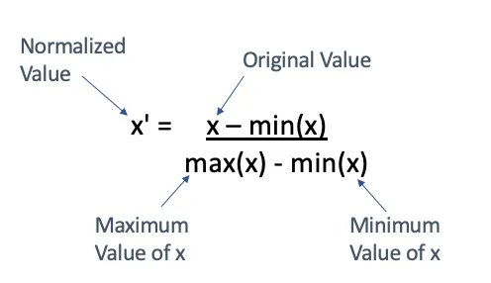
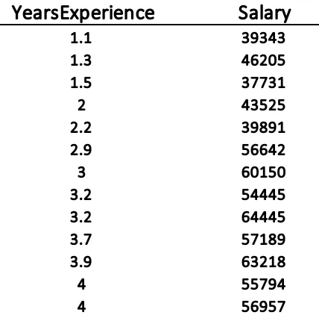
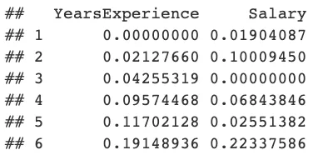
Data Preparation: Transformation
First 13 rows of the salary data
First 6 rows of Normalized data (Min-Max Normalization)
Notes:
https://medium.com/swlh/data-normalisation-with-r-6ef1d1947970

Slide 31
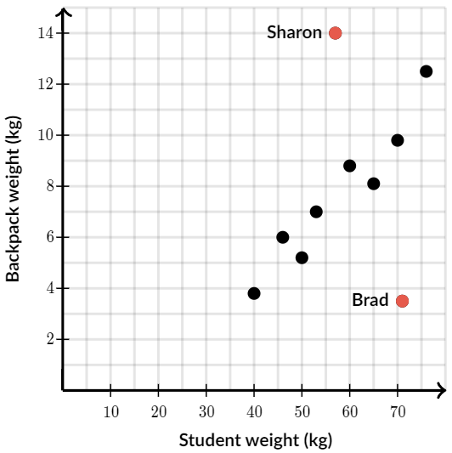
Data Preparation: Outliers
Outliers are those data points that are significantly different from the rest of the dataset. They are often abnormal observations that skew the data distribution, and arise due to inconsistent data entry, or erroneous observations.
Notes:
https://www.khanacademy.org/math/cc-eighth-grade-math/cc-8th-data/cc-8th-interpreting-scatter-plots/a/outliers-in-scatter-plots#:~:text=Scatter%20plots%20often%20have%20a,doesn't%20fit%20the%20pattern.&text=A%20scatterplot%20plots%20Backpack%20weight,%2C%2012%20and%201%20half).

Slide 32
Data Preparation: Outliers
Outliers may occur because of correct data capture (few people with income in tens of millions) or erroneous data capture (human height as 1.73 cm instead of 1.73 m). Regardless, the presence of outliers needs to be understood and will require special treatments.
Detecting outliers may be the primary purpose of some data science applications, like fake email detection, fraud or intrusion detection.

Slide 33
Data Preparation: Feature Selection
Reducing the number of attributes, without significant loss in the performance of the model, is called feature selection.
many data science problems involve a dataset with hundreds to thousands of attributes. In text mining applications, every distinct word in a document forms a distinct attribute in the dataset. Not all the attributes are equally important or useful in predicting the target. The presence of some attributes might be counter productive. Some of the attributes may be highly correlated with each other, like annual income and taxes paid.
A large number of attributes in the dataset significantly increases the complexity of a model and may degrade the performance of the model due to the curse of dimensionality

Slide 34
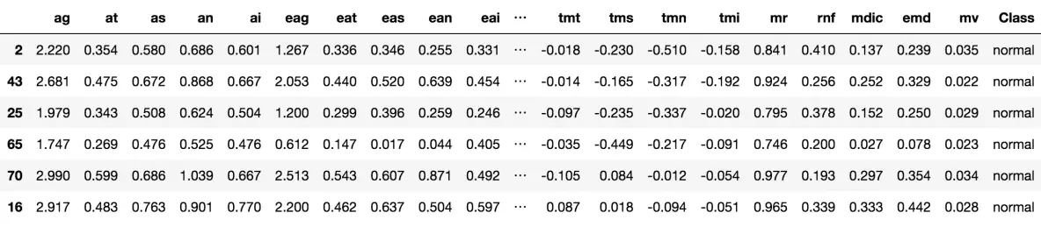
Data Preparation: Feature Selection
Glaucoma Dataset (62 features)
Notes:
https://www.machinelearningplus.com/machine-learning/feature-selection/

Slide 35
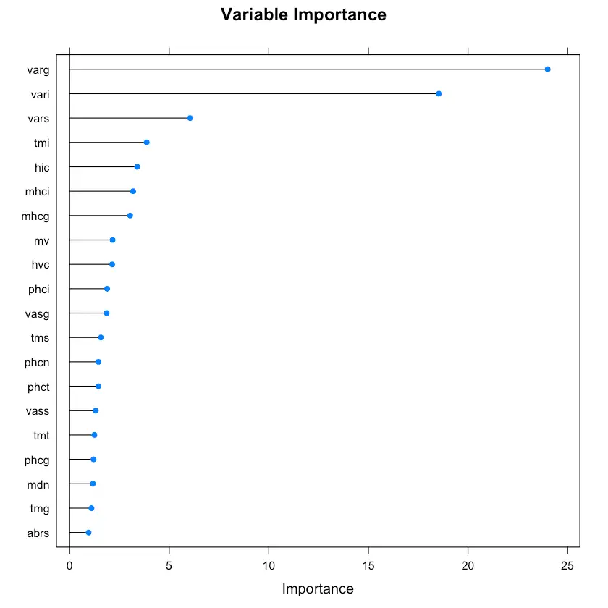
Data Preparation: Feature Selection
Glaucoma Dataset (62 features)
Regularized Random Forest – Variable Importance
Notes:
https://www.machinelearningplus.com/machine-learning/feature-selection/

Slide 36
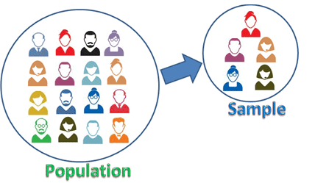
Data Preparation: Data Sampling
Sampling is a process of selecting a subset of records as a representation of the original dataset for use in data analysis or modeling. The sample data serve as a representative of the original dataset with similar properties, such as a similar mean. Sampling reduces the amount of data that need to be processed and speeds up the build process of the modeling.
In most cases, to gain insights, extract the information, and to build representative predictive models it is sufficient to work with samples. Theoretically, the error introduced by sampling impacts the relevancy of the model, but their benefits far outweigh the risks.
Notes:
https://sixsigmastudyguide.com/data-sampling/

Slide 37
Data Science Process

Slide 38
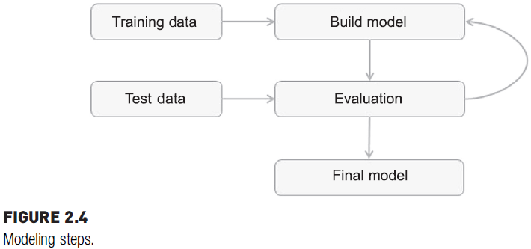
Modeling
A model is the abstract representation of the data and the relationships in a given dataset.
Predictive algorithms (classification and regression) require a prior known dataset to learn the model.
Descriptive data science techniques (Association analysis and clustering) where there is no target variable to predict; hence, there is no test dataset.
However, both predictive and descriptive models have an evaluation step.
The steps in the modeling phase of predictive data science.

Slide 39
Modeling: Training and Testing Datasets
The modeling step creates a representative model inferred from the data.
The dataset used to create the model, with known attributes and target, is called the training dataset.
The validity of the created model will also need to be checked with another known dataset called the test dataset or validation dataset.
To facilitate this process, the overall known dataset can be split into a training dataset and a test dataset.
A standard rule of thumb is two-thirds of the data are to be used as training and one-third as a test dataset.

Slide 40
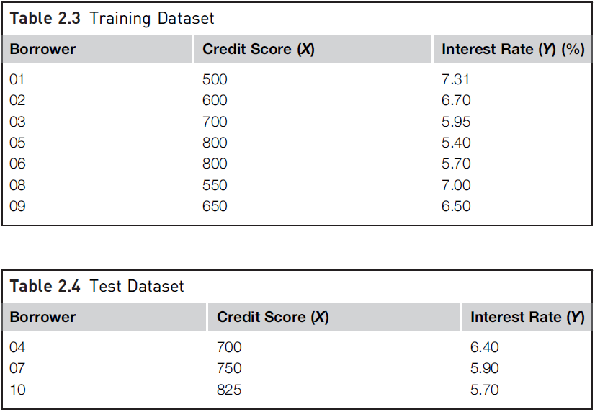
Modeling: Training and Testing Datasets

Slide 41
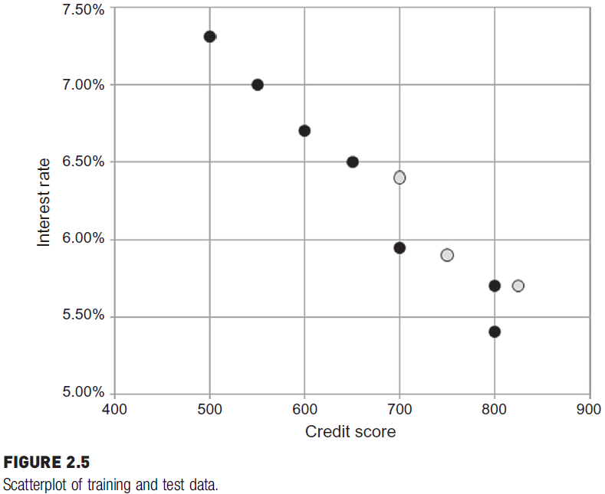

Modeling: Training and Testing Datasets

Slide 42
Modeling: Learning Algorithms
The business question and the availability of data will dictate what data science task (association, classification, regression, etc.,) can be used.
The practitioner determines the appropriate data science algorithm within the chosen category.
For example, we can use a simple linear regression technique to predict the interest rate for the interest rate dataset (Example seen earlier, See Slide 40).

Slide 43
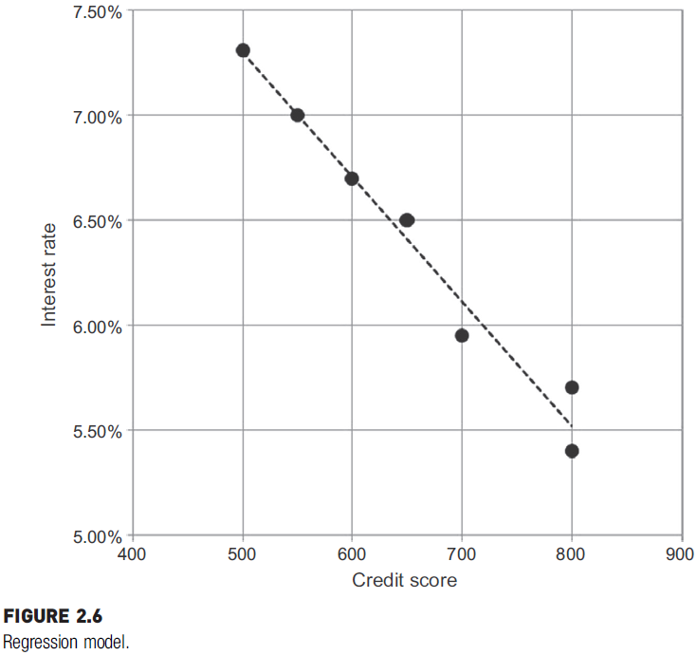
Modeling: Learning Algorithms
The line shown in the diagram serves as a model to predict the outcome of new unlabeled datasets.

Slide 44
Modeling: Evaluation of the Model
For the interest rate dataset, the model generated in the form of an equation is generalized and synthesized from seven training records.
A model should not memorize and output the same values that are in the training records.
The phenomenon of a model memorizing the training data is called overfitting.
An overfitted model just memorizes the training records and will underperform on real unlabeled new data.
The model should generalize or learn the relationship between credit score and interest rate.

Slide 45
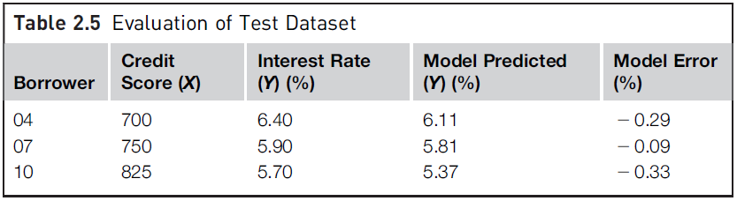
Modeling: Evaluation of the Model
The validation or test dataset, which was not previously used in building the model, is used for evaluation.
The actual value of the interest rate can be compared against the predicted value using the model, and thus, the prediction error can be calculated.

Slide 46
Modeling: Evaluation of the Model
As long as the error is acceptable, this model is ready for deployment.
The error rate also can be used to compare this model with other models developed using different algorithms like neural networks or Bayesian models, etc.

Slide 47
Modeling: Ensemble Modeling
Ensemble modeling is a process where multiple diverse base models are used to predict an outcome.
The motivation for using ensemble models is to reduce the generalization error of the prediction.
Even though the ensemble model has multiple base models within the model, it acts and performs as a single model.
Most of the practical data science applications utilize ensemble modeling techniques.

Slide 48
Modeling
At the end of the modeling stage of the data science process, one has:
analyzed the business question;
sourced the data relevant to answer the question;
selected a data science technique to answer the question;
picked a data science algorithm and prepared the data to suit the algorithm;
split the data into training and test datasets;
built a generalized model from the training dataset; and
validated the model against the test dataset.
After this step, the model of the interest rate dataset (example dataset) can be used to predict the interest rate of new borrowers by integrating it in the actual loan approval process.

Slide 49
Data Science Process

Slide 50
Application
Deployment is the stage at which the model becomes production ready or live.
The model deployment stage has to deal with:
assessing model readiness,
technical integration,
response time,
model maintenance
Notes:
The production readiness part of the deployment determines the critical
qualities required for the deployment objective. Consider two business use
cases: determining whether a consumer qualifies for a loan and determining
the groupings of customers for an enterprise by marketing function.
The models created by data science tools can be ported to production
applications by utilizing the Predictive Model Markup Language
(PMML) (Guazzelli, Zeller, Lin, & Williams, 2009) or by invoking data science
tools in the production application. PMML provides a portable and consistent
format of model description which can be read by most data science
tools. This allows the flexibility for practitioners to develop the model with
one tool (e.g., RapidMiner) and deploy it in another tool or application.
There are trade-offs to be made between
production responsiveness and modeling build time. The quality of prediction,
accessibility of input data, and the response time of the prediction
remain the critical quality factors in business application.
The key criterion for the ongoing relevance of the model is the representativeness
of the dataset it is processing. It is quite normal that the conditions in
which the model is built change after the model is sent to deployment.
Hence, the
model will have to be refreshed frequently. The validity of the model can be
routinely tested by using the new known test dataset and calculating the prediction
error rate. If the error rate exceeds a particular threshold, then the
model has to be refreshed and redeployed.
In the descriptive data science applications, deploying a model to live systems
may not be the end objective. The objective may be to assimilate the
knowledge gained from the data science analysis to the organization.

Slide 51
Data Science Process

Slide 52
Knowledge
The data science process provides a framework to extract nontrivial information from data.
To extract knowledge from these massive data assets, advanced approaches need to be employed, like data science algorithms, in addition to standard business intelligence reporting or statistical analysis.
The data science process starts with prior knowledge and ends with posterior knowledge, which is the incremental insight gained.
Notes:
As with any quantitative
technique, the data science process can bring up spurious irrelevant patterns
from the dataset. Not all discovered patterns lead to incremental knowledge.
Again, it is up to the practitioner to invalidate the irrelevant patterns and
identify the meaningful information. The impact of the information gained
through data science can be measured in an application. It is the difference
between gaining the information through the data science process and the
insights from basic data analysis.

Slide 53
Final Words
The whole data science process is a framework to invoke the right questions and provide guidance, through the right approaches, to solve a problem.
It is not meant to be used as a set of rigid rules, but as a set of iterative, distinct steps that aid in knowledge discovery.
Notes:
As with any quantitative
technique, the data science process can bring up spurious irrelevant patterns
from the dataset. Not all discovered patterns lead to incremental knowledge.
Again, it is up to the practitioner to invalidate the irrelevant patterns and
identify the meaningful information. The impact of the information gained
through data science can be measured in an application. It is the difference
between gaining the information through the data science process and the
insights from basic data analysis.

Slide 54
Summary
Any questions?

